Slide 1

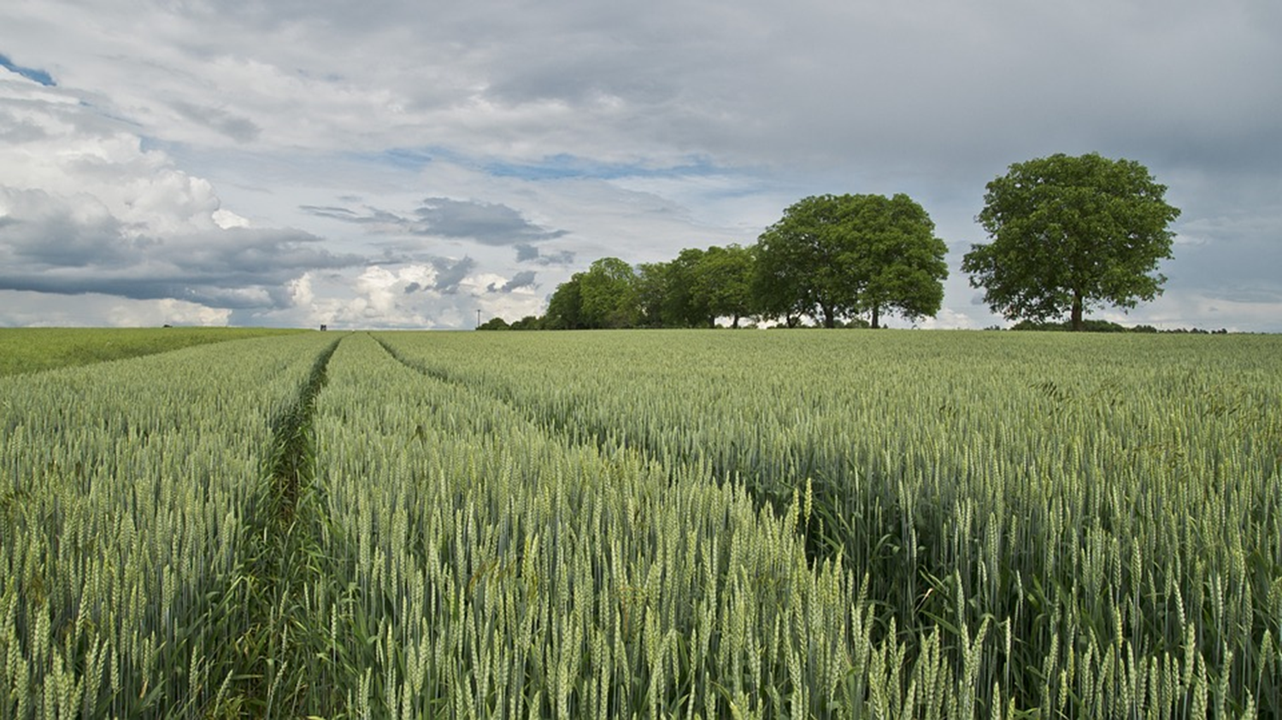
CROP YIELD PREDICTION
Presented By: jestin john

Slide 2
OBJCETIVES
The project focuses on predicting the “yield of crops” using machine learning algorithms
To apply three machine learning models to the dataset
To analyze the performance of each model and evaluate their accuracy and reliability..

Slide 3
TOOLS AND PLATFORMS USED
Front end: Gradio
Back end: Anaconda
Environment used: Jupyter notebook, Anaconda

Slide 4
FEATURES OF DATASET
STATE
ANNUAL RAINFALL
FERTILIZER USED
PESTICIDE USED
CROPS
PRODUCTION
SEASON
AREA
CROP YEAR
YIELD

Slide 5
PROCESS OF DATASET
Collect the Data
Data preprocessing: Label encoding
Select suitable models
Build and train the model
Test the model
Predict

Slide 6
MACHINE LEARNING MODELS USED
DECISION TREE REGRESSOR
Random Forest Regressor
XGB
Regressor
Each model` was evaluated based on:
Mean Squared Error
Mean Absolute Error
R² Score
Root of Squared Error

Slide 7
RESULT OBTAINED IN EACH MODEL
RANDOMFOREST REGRESSOR
MAE 13.321888313875219
MSE 53719.97278388332
RMSE 231.775694980908
R2 Score 0.95297253396812
XGB REGRESSOR
Mean Squared Error: 35926.774119919355 R2 Score: 0.9685490319148837
Mean absolute error: 14.052269957261432
RMSE 189.54359424659899
DECISION TREE REGRESSOR
Mean Squared Error:3511746243.7499824 R2 Score: 0.9502936578298463
Mean absolute error: 41784.005273191
RMSE:189.5439

Slide 8
CONCLUSION
WE USED XGB REGRESSOR,RANDOM FOREST REGRESSOR AND DECISION TRESS REGRESSION MODELS WHILE CREATING THE MODEL AND FOUND THAT :
XGB REGRESSOR MODEL HAVE THE BEST ACCURACY OF :
R2 Score: 0.9685490319148837

Slide 9
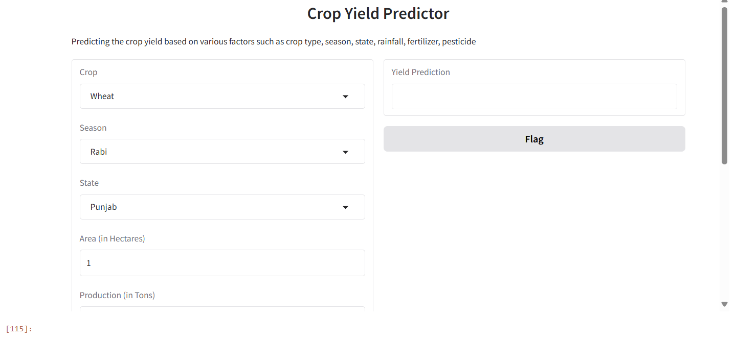
USER INTERFACE

Slide 10
REFERENCE
Restaurant Revenue Prediction Dataset , KAGGLE
URL:https://www.kaggle.com/datasets/akshatgupta7/crop-yield-in-indian-states-dataset

Slide 11


